Slide 1

Verlixir: Verification of Message-Passing Systems
Matt Neave

Slide 2
Why must we verify message-passing systems?
Recent rise in cloud-based clusters
Distributed systems are hard to reason about
Message-passing systems are a common implementation of IPC
Lots of research into the verification of sequential / shared-memory solutions
Lacking research into verification tooling for message passing, in particular, for actor-based systems

Slide 3
Concurrency
Multiple computations executed at same time
Threads / processes communicate with inter-process communication (IPC)
IPC typically achieved with shared memory or message passing

Slide 4
Actor Model
Model of computation where actors can:
Send messages to other actors
Spawn new actors
Act in response to a message

Slide 5
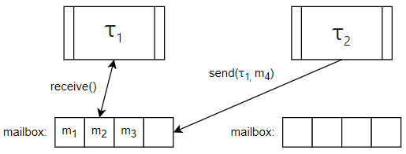
Actor Model

Slide 6
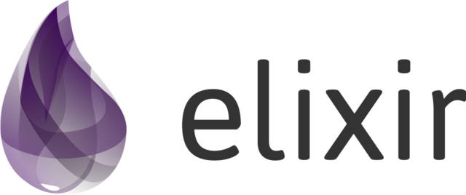
Elixir
Functional, concurrent, high-level programming language
Builds on top of Erlang – sharing abstractions for distribution and fault-tolerance

Slide 7
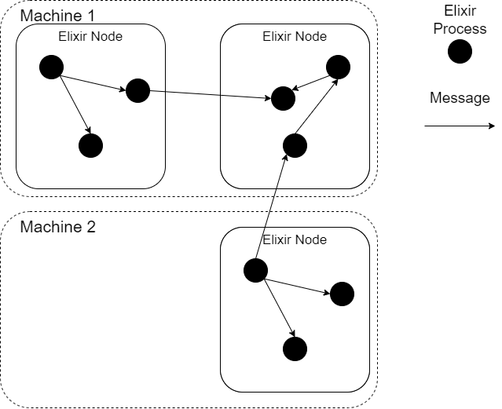
Elixir
# Spawn a new process
spawn(fn -> 1 + 2 end)
# Create a new BEAM instance Node.spawn(:"node1@localhost",
MyModule, :start, [])

Slide 8
Software Verification
Model Checking
Theorem Proving

Slide 9
Model Checking
Determining whether a model of system meets a specification
Typically, exhaustive search of all states (prone to state explosion)
Modern model checkers include Spin, PRISM, BLAST…

Slide 10
Verification-aware Languages
Programming language designed with built-in constructs to facilitate the verification of the program’s correctness
For example, Eiffel, Dafny
method sqrt(x: nat)
requires x >= 0
{
...
}

Slide 11
Why must we verify message-passing systems?
Recent rise in cloud-based clusters
Distributed systems are hard to reason about
Message-passing systems are a common implementation of IPC
Lots of research into the verification of sequential / shared-memory solutions
Lacking research into verification tooling for message passing, in particular, for actor-based systems

Slide 12
Verlixir
Verification-aware programming language for message-passing systems
Supports the simulation and verification of systems in a safe, controlled environment
Provides a specification language with support for linear-temporal time formulae, predicates and design-by-contract-style functions
Allows concurrent properties to be parameterized and verified over multiple configurations

Slide 13
Verlixir Example

Slide 14
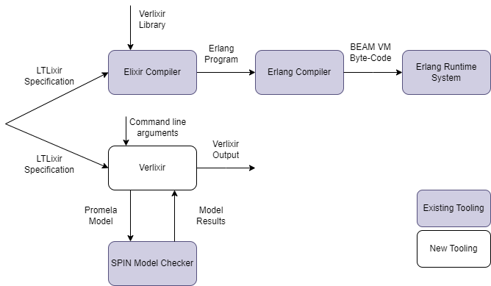
High-level Overview

Slide 15
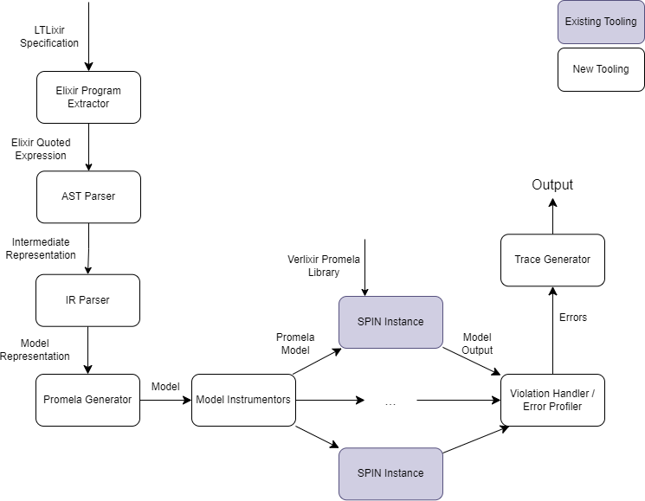
System Overview

Slide 16
Future Work
Combine model checking with theorem proving to build a more robust verification tool
Fault injection – determine if systems are fault tolerant by killing processes during verification
Computation-tree logic (CTL) support, i.e. for algorithms like Raft, where leader election is not guaranteed, we can determine there exists a path where a leader is elected

Slide 17
Final Remarks
Specifying systems in terms of safety and liveness should be apart of all software development
Verification-aware languages make system specification more accessible to developers
With rise of generative AI, we could move towards automatic system implementation from well formed system properties – the use of verification-aware languages can form a feedback loop to ensure the system correctness

Slide 18

Questions?

